Slide 1
S.O.L.I.D
(object-oriented design)
First five principles of Object Oriented Design
Trình bày :
Huỳnh Tấn Hòa
Trương Ngọc Tinh Anh

Slide 2

WHAT IS S.O.L.I.D ???

Slide 3
WHAT IS S.O.L.I.D ???
S Single-responsiblity principle (SRP)
O Open-closed principle (OCP)
L Liskov substitution principle (LSP)
I Interface segregation principle (ISP)
D Dependency Inversion Principle (DIP)
Let’s look at each principle individually to understand why S.O.L.I.D can help make us better developers.

Slide 4
Hot Tip
Purpose of S.O.L.I.D
When applied together, will make it more likely that a programmer will create a system that is easy to maintain and extend over time.
The principles of SOLID are guidelines that can be applied while working on software to remove code smells by causing the programmer to refactor the software's source code until it is both legible and extensible. It is part of an overall strategy of agile and Adaptive Software Development.

Slide 5

S Single-responsiblity principle (SRP)
A class should have one, and only one, reason to change.

Slide 6
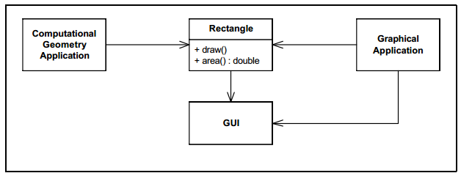
Hot Tip
S Single-responsiblity principle (SRP)
This design violates the SRP. The Rectangle class has two responsibilities. The first responsibility is to provide a mathematical model of the geometry of a rectangle. The second responsibility is to render the rectangle on a graphical user interface. The violation of SRP causes several nasty problems. Firstly, we must include the GUI in the computational geometry application. In .NET the GUI assembly would have to be built and deployed with the computational geometry application. Secondly, if a change to the Graphical Application causes the Rectangle to change for some reason, that change may force us to rebuild, retest, and redeploy the Computational Geometry Application. If we forget to do this, that application may break in unpredictable ways.

Slide 7
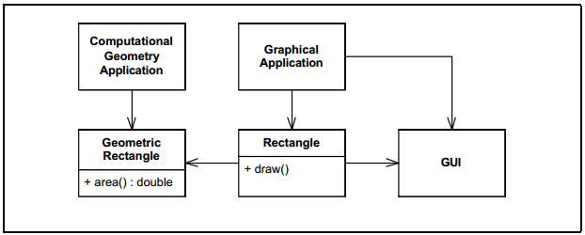
Hot Tip
S Single-responsiblity principle (SRP)

Slide 8


Hot Tip
CONCLUSION
The SRP is one of the simplest of the principles, and one of the hardest to get right. Conjoining responsibilities is something that we do naturally. Finding and separating those responsibilities from one another is much of what software design is really about.
Indeed, the rest of the principles we will discuss come back to this issue in one way or another.

Slide 9
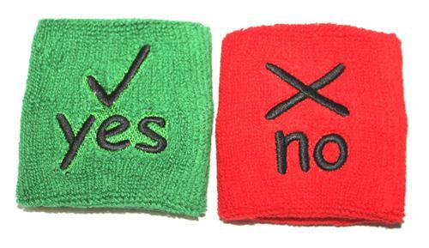
Hot Tip
O Open-closed principle (OCP)
SOFTWARE ENTITIES (CLASSES, MODULES, FUNCTIONS,...)
SHOULD BE OPEN FOR EXTENSION,
BUT CLOSED FOR MODIFICATION.
To avoid someone change the source code has stabilized and has passed the test

Slide 10
Hot Tip
O Open-closed principle (OCP)
They are “Open For Extension”. This means that the behavior of the module can be extended. That we can make the module behave in new and different ways as the requirements of the application change, or to meet the needs of new applications.
They are “Closed for Modification”. The source code of such a module is inviolate. No one is allowed to make source code changes to it.
ABSTRACTION IS THE KEY.

Slide 11
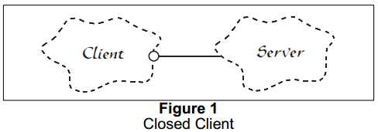
Hot Tip
O Open-closed principle (OCP)
Figure 1 shows a simple design that does not conform to the open-closed principle. Both the Client and Server classes are concrete. There is no guarantee that the member functions of the Server class are virtual. The Client class uses the Server class. If we wish for a Client object to use a different server object, then the Client class must be changed to name the new server class.

Slide 12
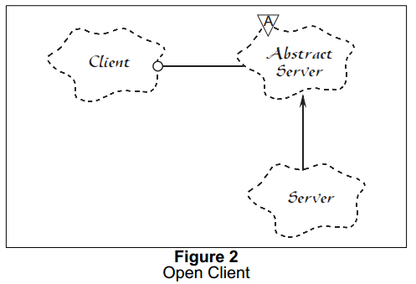
Hot Tip
O Open-closed principle (OCP)
Figure 2 shows the corresponding design that conforms to the open-closed principle. In this case, the Abstract Server class is an abstract class with pure-virtual member functions. the Client class uses this abstraction. However objects of the Client class will be using objects of the derivative Server class. If we want Client objects to use a different Server class, then a new derivative of the Abstract Server class can be created. The Client class can remain unchanged.

Slide 13
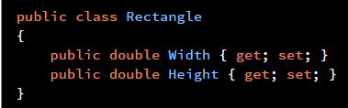
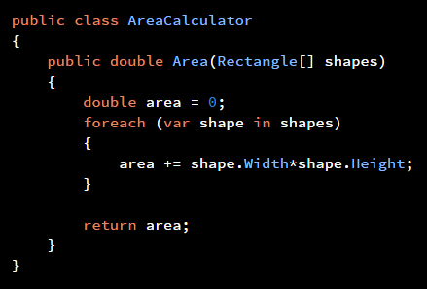
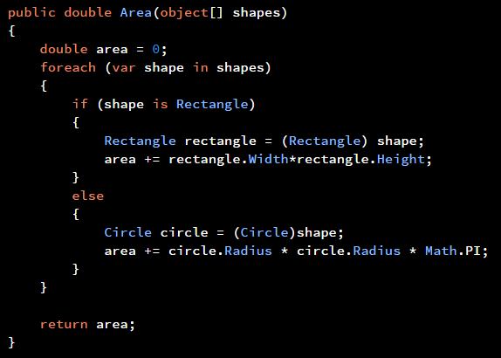
Hot Tip
EXAMPLE 1

Slide 14
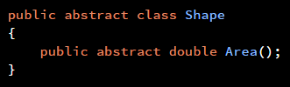
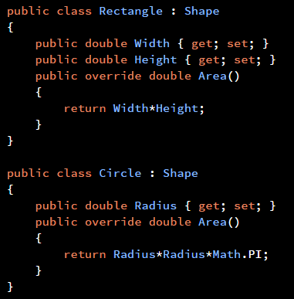
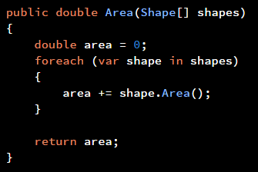
Hot Tip
EXAMPLE 2

Slide 15
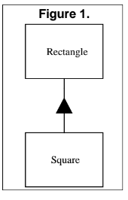
L Liskov substitution principle (LSP)
Substitutability is a principle in object-oriented programming that states that, in a computer program, if S is a subtype of T, then objects of type T may be replaced with objects of type S without altering any of the desirable properties of that program.

Slide 16
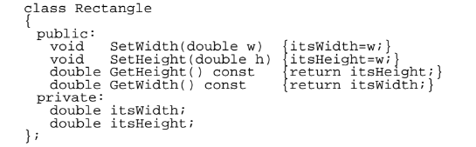
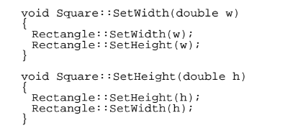
L Liskov substitution principle (LSP)

Slide 17
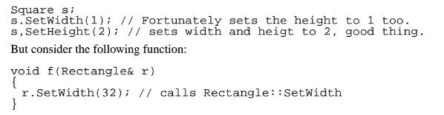
L Liskov substitution principle (LSP)

Slide 18
L Liskov substitution principle (LSP)
If we pass a reference to a Square object into this function, the Square object will
be corrupted because the height won’t be changed. This is a clear violation of LSP. The f
function does not work for derivatives of its arguments. The reason for the failure is that.
SetWidth and SetHeight were not declared virtual in Rectangle.

Slide 19
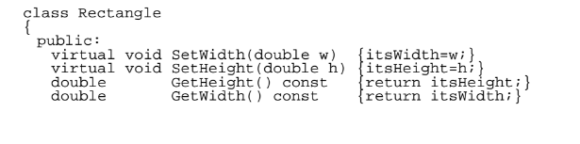
L Liskov substitution principle (LSP)

Slide 20
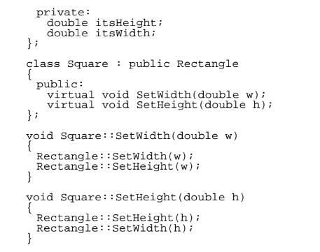
L Liskov substitution principle (LSP)

Slide 21
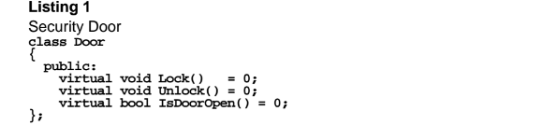
I The Interface Segregation Principle (LSP)
Make fine grained interfaces that are client specific.
Consider a security system. In this system there are Door objects that can be locked and
unlocked, and which know whether they are open or closed.

Slide 22
I The Interface Segregation Principle (LSP)
This class is abstract so that clients can use objects that conform to the Door interface, without having to depend upon particular implementations of Door. Now consider that one such implementation. TimedDoor needs to sound an alarm when the door has been left open for too long. In order to do this the TimedDoor object communicates with another object called a Timer.

Slide 23
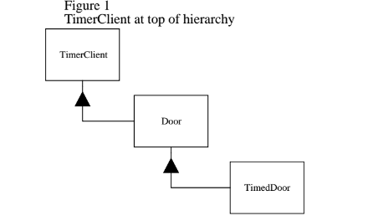
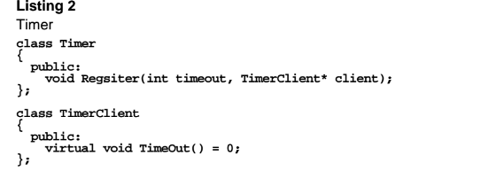
I The Interface Segregation Principle (LSP)
Although this solution is common, it is not without problems. Chief among these is that the Door class now depends upon TimerClient. Not all varieties of Door need timing.

Slide 24
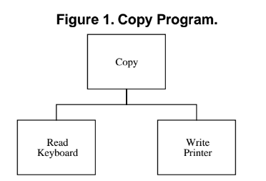
D The Dependency Inversion Principle (LSP)
A simple example may help to make this point. Consider a simple program that is charged with the task of copying characters typed on a keyboard to a printer.

Slide 25
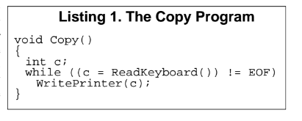
D The Dependency Inversion Principle (LSP)
The two low level modules are nicely reusable. They can be used in many other programs to gain access to the keyboard and the printer. This is the same kind of reusability that we gain from subroutine libraries.
However the “Copy” module is not reusable in any context which does not involve a keyboard or a printer. This is a shame since the intelligence of the system maintained in this module. It is the “Copy” module that encapsulates a very interesting policy that we would like to reuse.

Slide 26
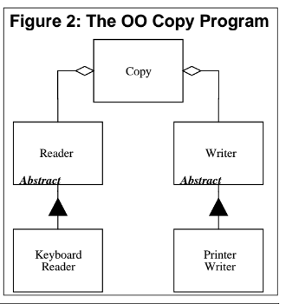
D The Dependency Inversion Principle (LSP)
One way to characterize the problem above is to notice that the module containing the high level policy, i.e. the Copy() module, is dependent upon the low level detailed modules that it controls. (i.e. WritePrinter() and ReadKeyboard()). If we could find a way to make the Copy() module independent of the details that it controls, then we could reuse it freely.

Slide 27
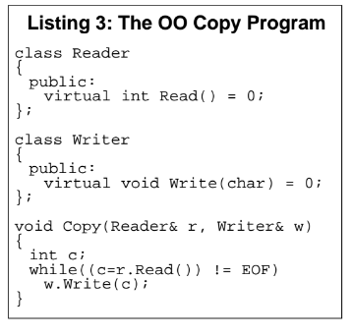
D The Dependency Inversion Principle (LSP)
Now we can reuse the “Copy” class, independently of the “Keyboard Reader” and the “Printer Writer”. We can invent new kinds of “Reader” and “Writer” derivatives that we can supply to the “Copy” class. Moreover, no matter how many kinds of “Readers” and “Writers” are created, “Copy” will depend upon none of them. There will be no interdependencies to make the program fragile or rigid. And Copy() itself can be used in many different detailed contexts. It is mobile.

Slide 28
TÀI LIỆU THAM KHẢO
1. The Principles of OOD
http://butunclebob.com/ArticleS.UncleBob.PrinciplesOfOod
2.A simple example of the Open/Closed Principle
http://joelabrahamsson.com/a-simple-example-of-the-openclosed-principle/

Slide 29
Thank You !
www.themegallery.com

